Slide 1
SDG 6:
Target 6.B
Notes:
Today we’ll be examining the SDG 6, Target B

Slide 2
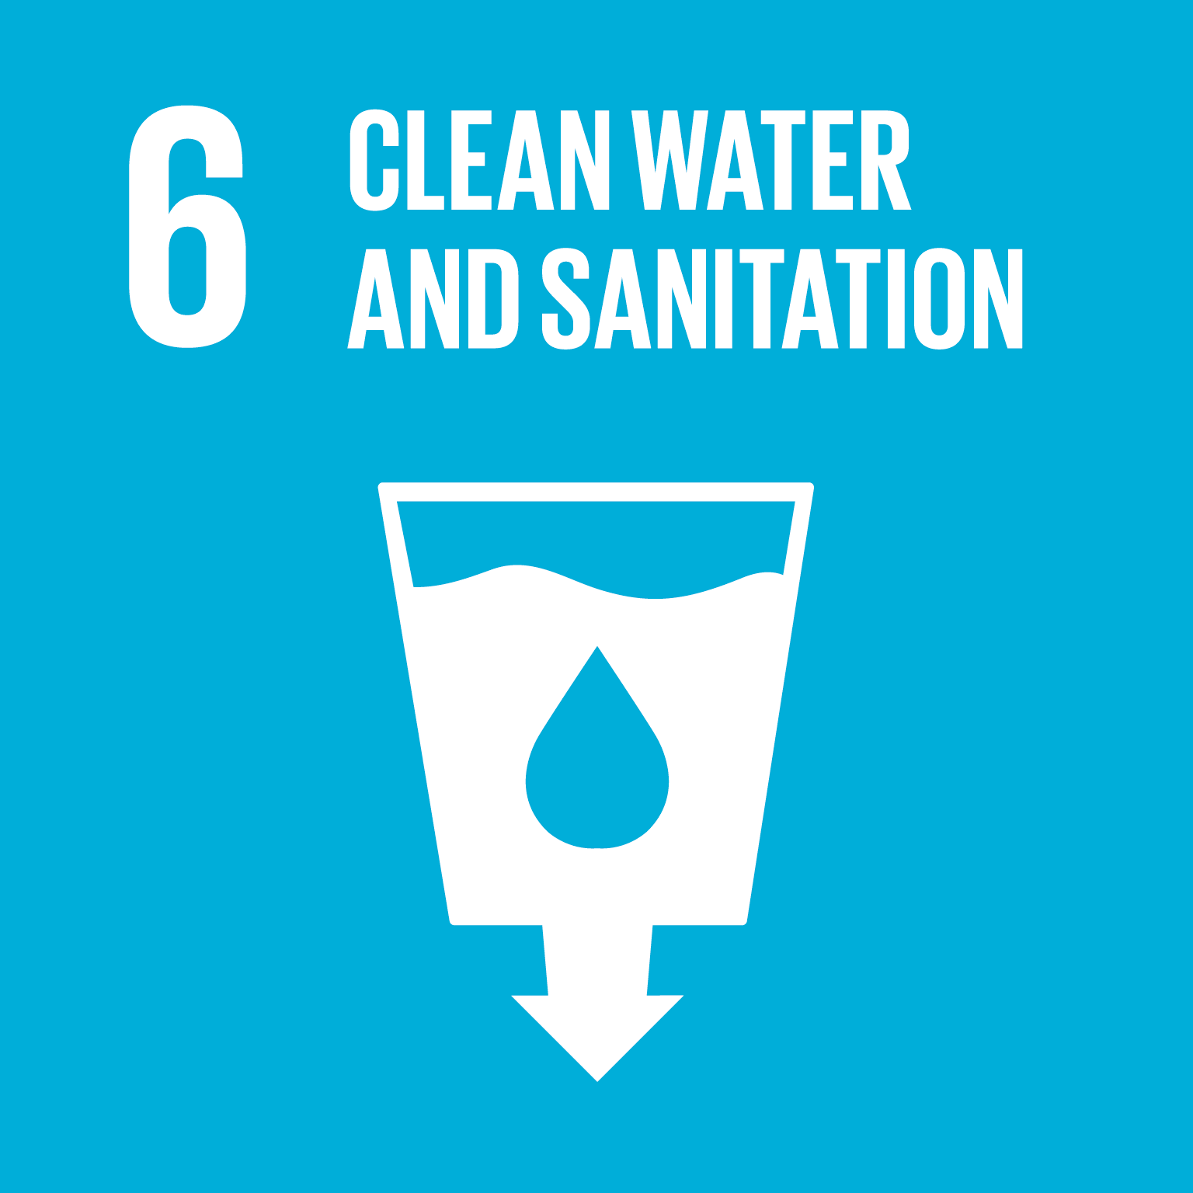
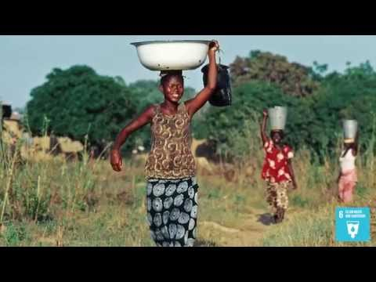
What is SDG 6?
“Ensure availability and sustainable management of water and sanitation for all.”
Notes:
As a quick refresher (or brief introduction) - sustainable development goal 6 is to “ensure availability and sustainable management of water and sanitation for all.” Here’s a short video highlighting some of the key issues this sustainable development goal addresses. *Play video.*

Slide 3
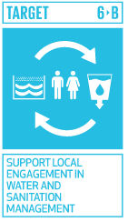
What is Target 6.B?
SUPPORT LOCAL ENGAGEMENT IN WATER AND SANITATION MANAGEMENT
“Support and strengthen the participation of local communities in improving water and sanitation management.”
Notes:
As stated by the United Nations, Target 6.B is “support and strengthen the participation of of local communities in improving water and sanitation management.”
In the following slides, we’ll break down this goal into its key components and how we can track progress on this goal.

Slide 4
How Can We Track Progress on Target 6.B?
Indicator(s) 6.B.1
Notes:
Target 6.B only has one indicator, referred to as 6.B.1. This indicator is how we measure progress for target 6.B and is meant to give us tangible evidence of changes in local community support in regard to water and sanitation management.

Slide 5
Indicator 6.B.1 : Proportion of local administrative units with established and operational policies and procedures for participation of local communities in water and sanitation management
Possible Metric:
Share of countries with clearly defined law or policy in water resources planning and management
Notes:
A possible metric we can use to track the progress under the indicator 6.B.1 is the share of countries with clearly defined law or policy in water resources planning and management

Slide 6
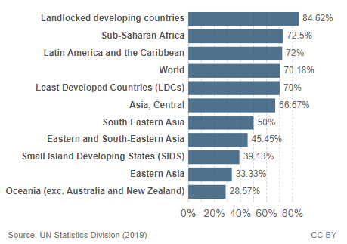
Indicator 6.B.1 Metric: Percentage of countries in each region with clearly defined law or policy in water resources planning and management
Notes:
This graph, created with data released by the UN Statistics Division, depicts the percentage of countries in each region with clearly defined law or policy in water resources planning and management in the years from 2017 to 2019. As we can see, landlocked developing countries have the highest percentage with 84.62%. Oceania (exc. Australia and New Zealand) has the lowest percentage with 28.57%.

Slide 7
130 UN Member States
have reported data under indicator 6.B.1 in the last five years
Source: UN Water, 2019
Notes:
Reporting data under certain categories is optional for UN Member States. For indicator 6.B.1, stakeholder participation is measured using multiple indicators like water resourcing and planning, urban sanitation, and hygiene promotion and are not aggregated into one overall value. 130 UN Member States chose to report data under indicator 6.B.1 in the last 5 years which is equivalent to about 80% of UN signatories reporting.

Slide 8
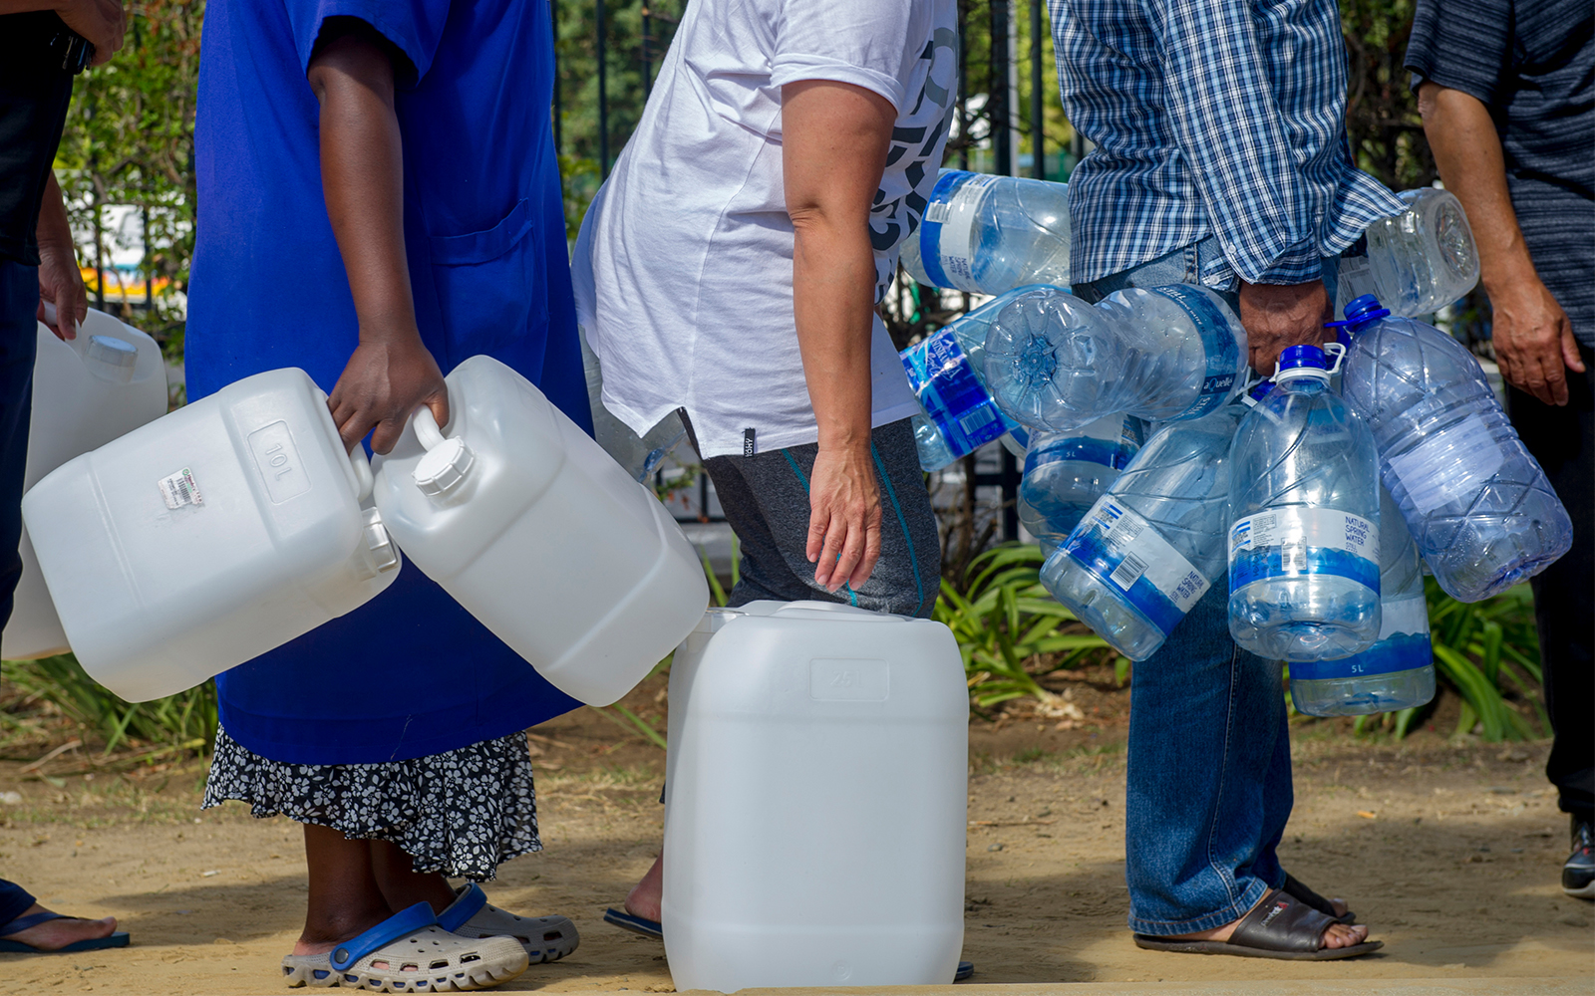
Case Study - South Africa
Country Statistics
Population: 58,500,000
Geographical distribution: 67% reside in urban areas, 33% in rural areas
Country Statistics on Water
44% of South Africans have access to a basic hand washing facility
52% of water bodies have a good ambient water quality
95% of transboundary basin areas have an operational agreement for water cooperation
Notes:
A case study relevant to target 6.B is South Africa. Before we delve into South African law and procedures on water and sanitation management, let’s examine some country statistics. The population of South Africa is approximately 58.5 million, with about ⅔ of the population residing in urban areas. Less than half of the population has access to a basic hand washing facility. 52% of the water bodies in the area have good ambient water quality and 95% of the transboundary basin areas have an operational agreement for water cooperation.

Slide 9
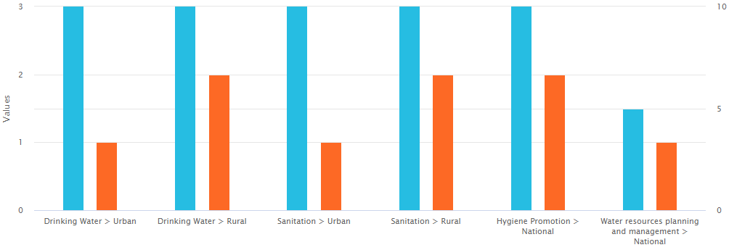
Case Study - South Africa
Procedures in law or policy for participation by users/communities and level of participation in South Africa
Level of participation (3=high, 2=moderate, 1=low)
Existence of procedures (10= clearly defined, 5= not clearly defined)
Source: WHO, UNICEF, UN Water
Notes:
In this graph we can see the procedures in law or policy for participation by users and communities, as well as the level of participation. The level of participation is measured on a 3-point scale with 1 being low, 2 being moderate, and 3 being the highest amount of participation. The existence of procedures is measured with a 5 for procedures that are not clearly defined and with a 10 for clearly defined procedures.
In every category, the procedures in place in law and policy for participation by users and communities is rated higher than that of the measured participation by users and communities

Slide 10
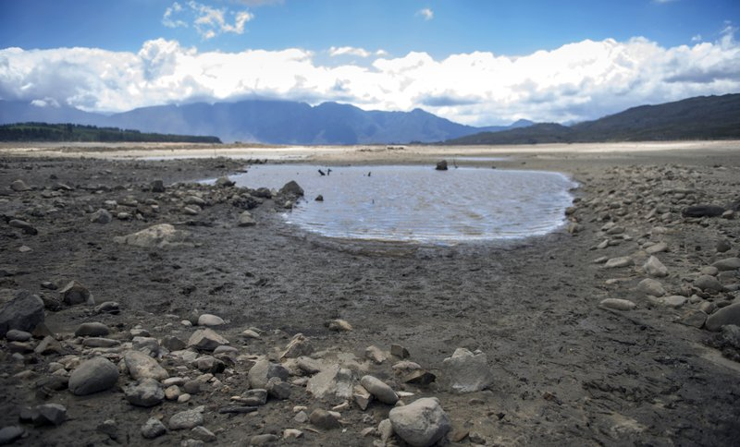
Water Scarcity in Cape Town- A Case for Law and Policy
Cape Town Water Crisis
2015-2020
Peak years: 2017-2018
4 million people directly impacted
Response
Limit water usage
Recommendations
Impose fines
Lasting Impact
Possibility for future shortages
Notes:
For the rest of this case study, we will be focusing on Cape Town and the Cape Town water crisis in the Western Cape of South Africa from 2015-2020. The peak of the water crisis, however, was between mid-2017 and mid-2018. Approximately 4 million people were directly affected by the water crisis, required to wait in long lines for a daily allocation of 15-25 litres of water.
The response from the government was to drastically reduce the amount of water residents could use and impose fines if anyone was caught using more than their allotted amount. At official water collection sites, security guards ensured that no one was taking more than their fair share of water. The city’s leaders also issued recommendations to residents and tourists alike, urging them not to flush toilets, skip showers, and swim in the ocean instead of in pools. “Day Zero” refers to the estimated date that the city would reach a critical amount of water available in the reservoir and would be forced to shut off the taps. The city insisted that if “Day Zero” was reached, taps would still run in hospitals. Additionally, efforts would be made to allow communal taps in informal neighborhoods to run; areas that experienced water insecurity prior to the water crisis.
According to the WWF, despite the drought ending in 2020 due to rains filling the dam levels to 95%, the possibility for another drought in Cape Town is not only possible, but likely. The programs that drastically reduced water usage like the “if it’s yellow let it mellow campaign” and daily allocation of a specific amount of water, ended along with the drought. Additionally, growing populations and urbanization have resulted in the WWF estimating that water demand in the area will only increase, putting stress on the already fragile water resources. The creation and enforcement of robust water laws and regulations to prevent another water crisis, like policies for using groundwater sustainably and catchment management would be beneficial.
This picture taken during the height of the water crisis in January of 2018 depicts the main water source for Cape Town, the Theewaterskloof dam.

Slide 11
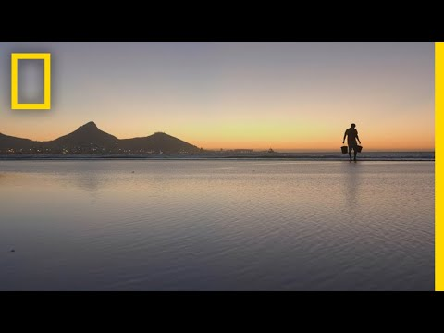
Water Scarcity in Cape Town
Notes:
This short video by National Geographic further explains the water crisis in Cape Town, explores how climate change is involved in the changing environment, and examines how Cape Town may become a blueprint for future water crises

Slide 12
How Does Target 6.B Relate to Other Targets?
Notes:
The way in which all SDGs interact and relate is complex and achieving progress on one SDG often necessitates achieving progress on another. As can be seen in this slide, the same goes for achieving progress within one SDG. Though these targets are useful to help track progress in any one area, it is also necessary to examine and think critically about how these targets interact.

Slide 13
Sources
https://www.globalgoals.org/
https://www.globalgoals.org/6-clean-water-and-sanitation
https://sdg-tracker.org/water-and-sanitation
https://sdg-tracker.org/
https://sdg6data.org/indicator/6.b.1
https://sdg6data.org/country-or-area/South%20Africa#anchor_6.b.1
https://www.washingtonpost.com/graphics/2018/world/capetown-water-shortage/
https://apnews.com/article/fe3f700c0ff14fa2b5d4743ecc47464f
http://awsassets.wwf.org.za/downloads/wwf009_waterfactsandfutures_report_web__lowres_.pdf
Notes:
These are the sources used to gather the information in the target 6.B slide deck

